Slide 1






Putting People at the Heart of What We Do
Adult Social Care Practice Framework
The Royal Borough of Kingston upon Thames

Slide 2
Introduction | Page 3
The Council’s Vision & Values | Page 4
Adult Social Care’s Vision & Values | Page 5
Key Principles of Practice | Page 6
Bedrocks of Practice | Page 11
 | Page 12
Contents
2

Slide 3





Introduction
Putting People at the Heart of What We Do is the council’s Practice Framework setting out how we deliver Adult Social Care. Putting People at the Heart of What We Do outlines the approaches our practitioners are expected to follow, supporting the development of high quality practice.
This is not a rigid set of rules, but intended as a useful set of principles and guidelines that underpin our professional judgment and practice. We want this to support the fostering of positive change with a focus on consistency, quality, and equity in the way we work together to put residents at the heart of what we do to make a positive difference.
This Practice Framework was co-produced with residents drawing on care and support, carers, staff across all Adult Social Care operational teams, providers, and partners. It was really important to us that everyone was able to have a say to shape what our practice should look like.
Key Principles
Prevention at every intervention
Independence first
At every involvement we take proactive action to prevent or delay needs for care and support to ensure that people live and age well.
We empower people to make their own choices and support to help people do as much as they can for themselves.
Maximising Strength
Promoting Safety
We build on what works for people and draw on their strengths and assets to support them in achieving the outcomes that matter to them.
We work together with residents and partners to keep people safe, whilst respecting autonomy and agency in life choices.
Bedrocks
Person Centered
Value & Sustainability
We put people at the heart of what we do by personalising our approach to what the key principles of practice mean to people drawing on care and support and their carers.
We are committed to ensuring equity in how we utilise the resources available to us, and we strive for care to be provided in a way that is fair and accessible to everyone who needs it.
3

Slide 4








The Council’s Vision & Values
Our Council Vision
Putting People at the Heart of What We Do reflects RBK’s Council Vision to create a "Greener, Fairer, Safer, Together" borough, focusing on sustainability, equality, safety, and community collaboration to achieve shared ambitions.
Our STAR values - Supportive, Transparent, Appreciative, and Respectful, underpin everything we do and are also embedded in the way that we work in Adult Social Care with residents to enable collaboration and empowerment.
Our values encourage everyone to welcome diversity of thought in shaping inclusive services.
Working with partners and communities to ensure the borough is:
Our children and young people have a fairer start in life and residents are supported when needed throughout their lifetime. Inequality has been reduced and every resident has increased opportunities for a happy and healthy life.
SUPPORTIVE
of trying new ideas, with the courage to change direction.
TRANSPARENT
and connected in all that we think, say and do.
We are a greener and more sustainable borough and on track to meet our net zero carbon targets.
Our borough stays safe, well maintained and resilient so individuals and communities can thrive and prosper.
APPRECIATIVE
of each other, recognising and celebrating success.
We have strong relationships with partners and work together with our communities to achieve our shared ambitions.
RESPECTFUL
of difference and valuing diversity.
We have a Future Council commitment to ensure that the council is ready for the future, is managed effectively and responsibly in the best interests of our communities and delivery support. Our vision and aspirations are further set out in our ‘Inclusive Kingston’ Equality, Diversity and Inclusion Strategy.
4

Slide 5



Our Vision for Adult Social Services
We set out our vision for Adult Social Care in 2024. Putting People at the Heart of What We Do is intended to support us in making the vision come alive with what we do in practice. We work hard on making a positive difference to the lives of those drawing on care and support from Adult Social Care, and want people to have a positive experience of care and support and for our involvement to have had a positive impact on their wellbeing.
Adult Social Care and Health - Our Vision
“Working together to make a positive difference”
Council
Partnership
We listen to and understand our residents.
We recognise the strengths, challenges and needs of our diverse communities.
We ensure safety is at the core of how we doing things.
Our workforce feel valued, supported and empowered.
We collaborate with partners to deliver healthier communities and joined up care.
We embed innovation and learning across everything we do.
We ensure choice and high quality services.
We work together to ensure a financially sustainable health
and care system.
Residents
We put people at the heart of what we do.
5

Slide 6
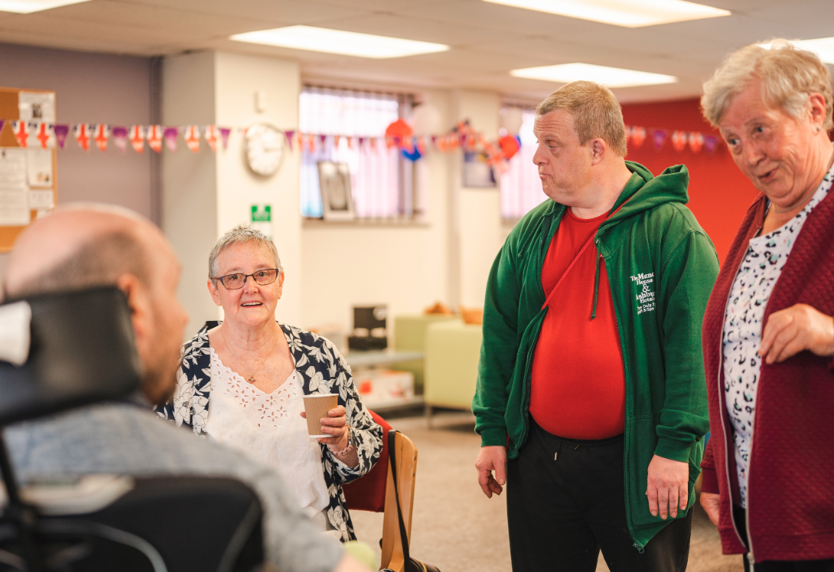

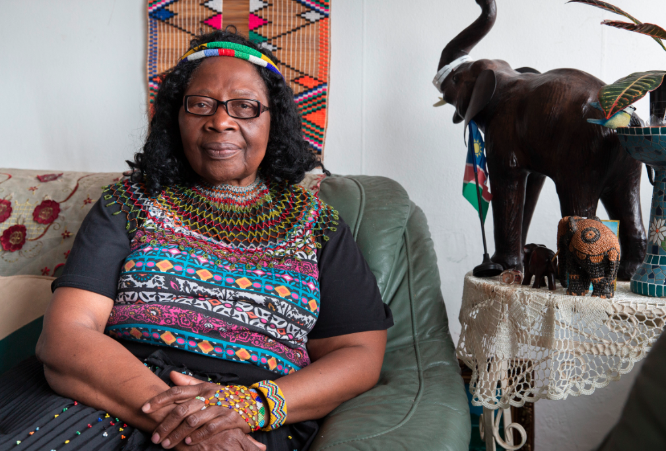
Key Principles of Practice
4 Key Principles of Practice underpin everything we do all all stages of care and support with Adult Social Care:
Prevention at every intervention
Independence first
At every involvement we take proactive action to prevent or delay needs for care and support to ensure that people live and age well.
We empower people to make their own choices and support to help people do as much as they can for themselves.
Maximising Strength
Promoting Safety
We build on what works for people and draw on their strengths and assets to support them in achieving the outcomes that matter to them.
We work together with residents and partners to keep people safe, whilst respecting autonomy and agency in life choices.
6

Slide 7
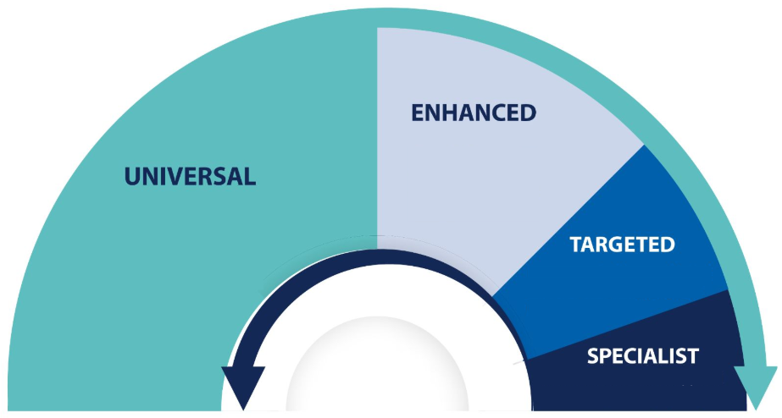



Key Principles of Practice
Prevention at every intervention
At every involvement we take proactive action to, where possible, prevent or delay future needs for care and support to ensure that people live healthier lives and age well. We use professional curiosity to inquire deeper about what is happening and are aspirational about what else could be done to support someone’s wellbeing. We give tailored information and advice to people that aligns with their future wishes and plans, and maintain professional curiosity for steps we can take to support wellbeing even if everything is going well now.
Approaches that can support this:
Relationship-based practice
Relationship-based practice recognises that strong, trusting connections between social care staff and individuals they support are the primary vehicle for effective intervention and positive change. This approach emphasizes empathy, respect, trust, open communication, and collaboration, acknowledging that individuals' experiences and emotions are central to their well-being. Relationship-based practice supports prevention by fostering trust and collaboration, enabling early intervention, building resilience, and promoting supportive social connections.
7

Slide 8



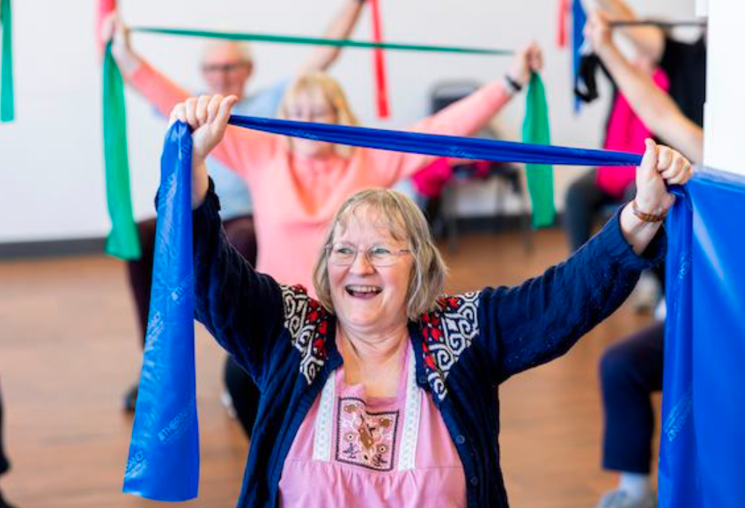
Key Principles of Practice
Independence first
We empower people to make their own choices and support to help people do as much as they can for themselves. We collaborate with people and partners to understand their own abilities, goals, and aspirations. The actions we take support independence.
“I think it is so important for all of you to realise what a difference you make. Just today I was able to talk to Citizens Advice on my landline phone, and hear everything. I am able to get to all of my medical appointments because if I need to reschedule, I can just ring up.” Watch and listen to Debbie’s full story on YouTube
Approaches that can support this:
Empowerment
Empowerment in social care centers on enabling individuals to control their lives by prioritising their needs and respecting their choices. It emphasises building on strengths rather than deficits, fostering autonomy and participation in decision-making. This approach involves challenging oppression, advocating for rights, and facilitating access to resources, promoting social inclusion. Ultimately, it shifts practice from "doing for" to "doing with," fostering self-determination.
8

Slide 9
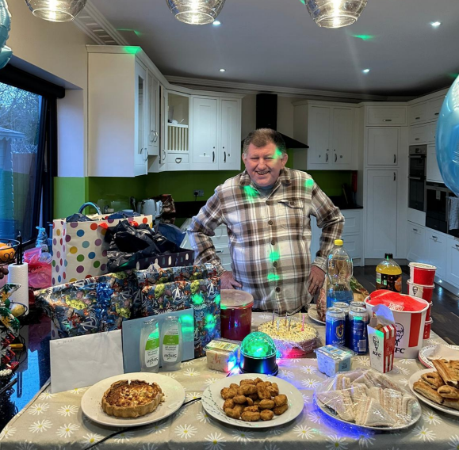


Key Principles of Practice
Maximising Strength
We see people as unique individuals with skills, strengths and goals. We build on what works for people and draw together the strengths and assets available to support them in achieving the outcomes that matter to them. We help coordinating these various existing resources.
Approaches that can support this
Strength based practice
Essential to the delivery of this framework is taking a ‘strength-based’ practice approach which is key to effective social work, occupational therapy, social care interventions and achieving the best outcomes for people. The Care Act 2014 emphasises that local authorities should consider the person’s own strengths and capabilities, what support might be available from their wider network or within the community to help.
9

Slide 10

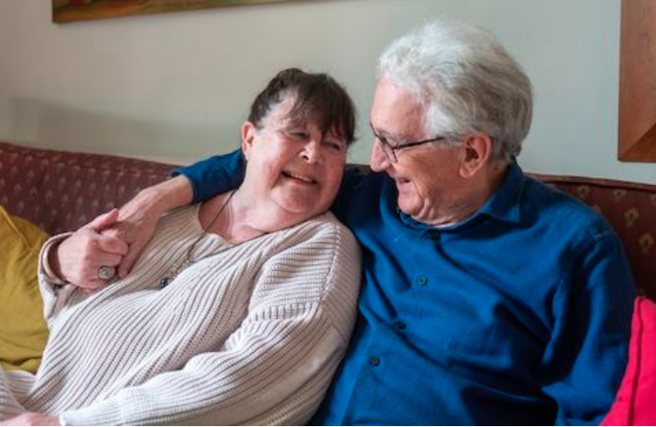
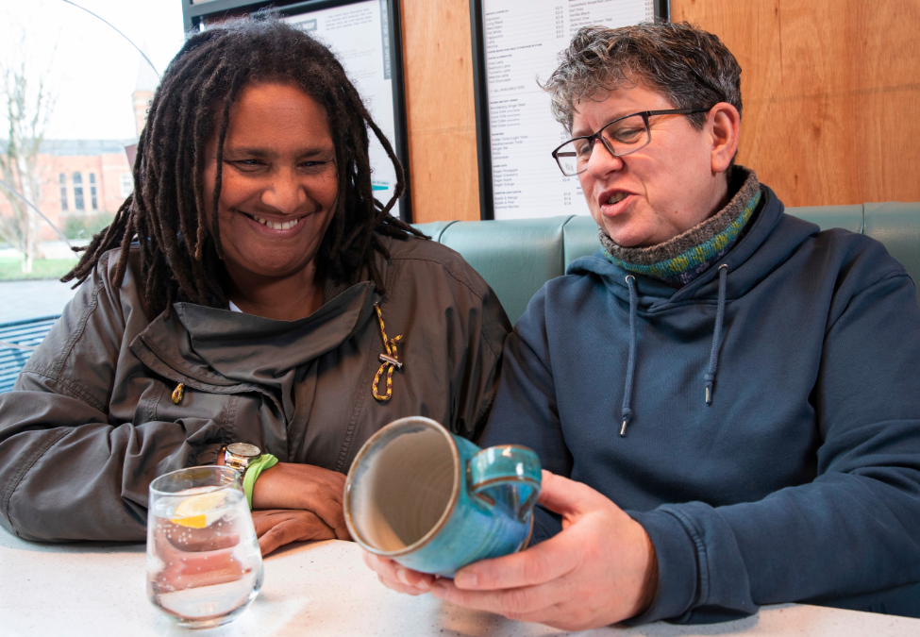
Key Principles of Practice
Promoting Safety
We work with people to understand what being safe means to them, and collaborate with partners to improve people’s lives. Our focus is on enhancing lives and respecting people’s autonomy and agency in life choices to live the lives that they want, while upholding the right to live safely, free from bullying, harassment, abuse, discrimination, avoidable harm, and neglect.
“Mum not only 'has her freedom back' but is safe and able to get on with living her life again”.
Approaches that can support this
Positive risk taking
This involves a balanced approach, prioritizing an individual's autonomy and well-being while acknowledging potential risks. It shifts from solely avoiding harm to enabling individuals to pursue meaningful experiences and independence. This requires careful assessment, collaborative planning, and support to maximise positive outcomes while minimising negative ones.
10

Slide 11
Bedrocks of Practice
Our approach to implementing our practice principles is grounded in two fundamental ‘bedrocks’, Person Centred Practice and Value & Sustainability -
Person Centred Practice
Person Centered
We put people at the heart of what we do by personalising our approach to what the key principles of practice mean to people drawing on care and support and their carers.
Implementing Practice Principles
Value & Sustainability
We are committed to ensuring equity in how we utilise the resources available to us, and we strive for care to be provided in a way that is fair and accessible to everyone who needs it.
Value & Sustainability
These foundational elements ensure that our practices are consistently applied in a manner that aligns with our core values and overarching goals.
11

Slide 12

Bedrocks of Practice
Person Centred Practice
Approaches that can support this
Co-production
Adult Social Care and individuals who draw on care and support working together as equal partners in every stage of their support. This means collaboratively defining goals, developing plans, and actively participating in reviews, ensuring the individual's voice and lived experience directly shape the process. It fosters a relationship where both parties contribute their unique expertise, leading to more relevant and effective outcomes.
We put people at the heart of what we do by personalising our approach to what the key principles of practice mean to those we work with. We do not believe that there is a one size fits all solution to meeting needs. We make sure to get to know an individual's needs, wishes, preferences, and desired outcomes, and are flexible in how we work to ensure we tailor our support to what is best for them. We maximise people’s independence, choice, and control.
“Her approach is undeniably person-centred. She takes the time to truly understand the individual’s unique needs, making thoughtful adjustments to care plans.”
Allyship
To foster equitable and just support, we actively challenge power imbalances and systemic inequalities while advocating for the rights and dignity of marginalised groups. This necessitates understanding and valuing each person's unique identity, which is shaped by individual characteristics, including ethnicity, disability, gender, age, and more. We understand that these characteristics “intersect” with one another and overlap, and can affect people’s different experiences of both marginalisation and privilege.
11

Slide 13

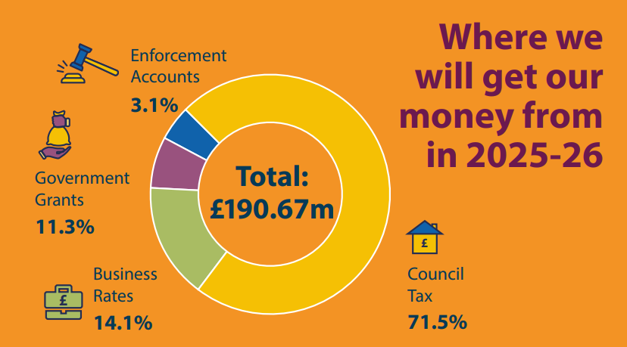

Bedrocks of Practice
Value and sustainability
Approaches that can support this:
Systems Theory
Systems theory encourages a holistic view of individuals and communities, recognizing the interconnectedness of various factors influencing their wellbeing. Considering System Theory helps us understand how resource allocation impacts different parts of the system and identify potential unintended consequences. It promotes efficiency by understanding the whole system.
We are committed to ensuring equity in how we utilise the resources available to us, and we strive for care to be provided in a way that is fair and accessible to everyone who needs it. We take reasonable considerations of the value of the services that we provide, ensuring that we work in partnership with people to think about what options there are to meet needs.
12

Slide 14

How will we know we’ve made a difference??
Accountability
We know that good Adult Social Care support can change people’s lives by helping them be happy, feel fulfilled, and enjoy their lives. We will keep this Practice Framework under yearly review.
Our Quality Assurance Framework outlines the key principles, standards, and processes that we follow to deliver high-quality, person-centred care. It provides a structure for continuous improvement, enabling the identification of areas of strength and areas for development as a result of reflection through supervision and appraisal, feedback, and learning and development.
The Aims of our Quality Assurance Framework is:
To apply quality standards across RBK Adult Social Care.
To take a consistent approach to how we monitor and evaluate quality.
To celebrate good practice and success.
To take action to support quality improvements where necessary.
To contribute to organisational development and learning.
Positive outcomes should be reflected in the following areas:
Feedback from people using services
Complaints and compliments
Supervision audits
Supervision surveys
Direct observations of practice
Case file audits
Thematic audits
Corporate and External audits
CQC Quality Assurance feedback
13

